Slide 1
EGYQUETTE
Connecting the World to Egypt’s Finest Offerings

Slide 2
Prepared by
1- Marym Gamal
2- Shaimaa Magdy
3- Mohamed Alaa El Din
4- Ebtesam Sabri
Under Supervision of
Dr. Tamer El Moghazy

Slide 3
Table of contents
01
02
03
04
05
06
About us
Market analysis
Goals & strategy
Content plan
Budget
KPI overview

Slide 4
01
About us

Slide 5

Our company
Egyquette will be The Online Gateway to Unlock Egyptian Exports potentials.
Since Egypt is moving towards the development of its economy which requires a boost in export volume along with expansion of its export capacity, seeing such a challenge in which Egyptian companies struggle to reach international buyers, consequently hindering export growth and economic development. We came out with the idea of creating a comprehensive, user-friendly online directory showcasing Egyptian companies and their offerings to the world.

Slide 6
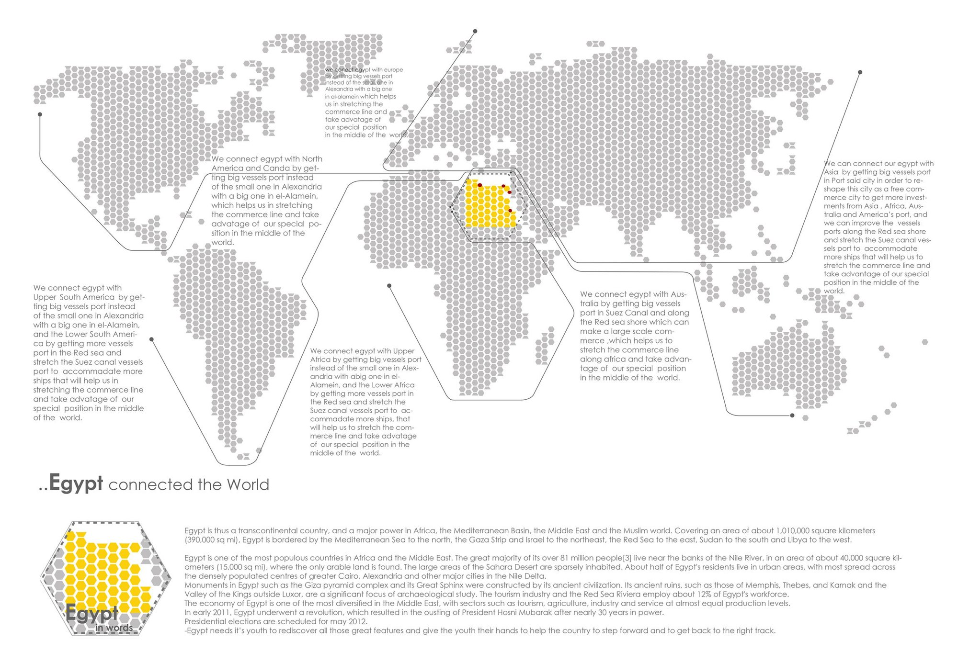
Europe
Asia
North America
Latin America
Australia
Africa

Slide 7
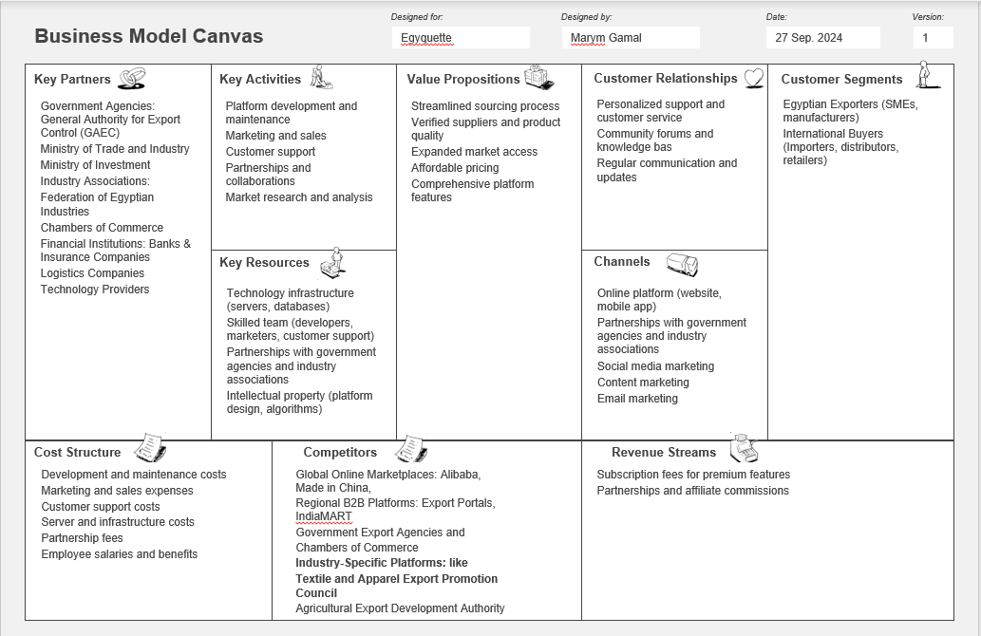

Slide 8

SWOT Analysis
Strengths:
Weaknesses:
Comprehensive and user-friendly directory.
Strong network of trusted Egyptian exporters in all fields.
Mobile friendly
Verified by Ministry of Industry, Trade and Supply
The lack of sufficient awareness about the new directory may lead to a lack of trust.
Lack of technical and financial resources.
No experience in logistics for some team members
.
Opportunities:
Threats:
Growing global interest in Egyptian product
The growth of using technology around the world
The government support for exporters, it has plan to increase exporting to 140 Bilion USD by 2030
Devaluation of EGP.
Economic fluctuations affecting international trade.
Political and economic instability worldwide
Countries that competing Egypt in exporting same products.
Shipping & trade
problems

Slide 9
140 Billion USD
Egypt’s Export revenue goals
by 2030

Slide 10
SMART Objective
Launch Egyquette Website by Mar. 2025.
List about 1500 verified and trusted companies data.
Reach traffic on website to be 10,000 visits within the first six months.
Increase brand awareness among international buyers and investors by 30% within the first twelve months.
Launch LinkedIn page within 2 months after the Launch.
Send 100 email weekly to generate leads.
Start Generate at least 100 qualified leads per month and convert 25% of them into paying customers within the next 2 years.
Achieve a customer satisfaction rating of 85% or higher based on user surveys and feedback.
Increase social media followers to be 10000 followers by the first 2 months and achieve an average engagement rate of 15% within the next six months
Earn 100,000 EGP & 10,000 USD from subscription after 2 years of the launch.

Slide 11



Segmentation, Targeting, and Positioning (STP)

Slide 12
Segmentation
Target Audience:
International Businesses: Companies looking for new suppliers, partners, or products from Egypt.
Investors: Individuals and institutions seeking investment opportunities in Egyptian businesses.
Egyptian Businesses: Companies seeking to expand their reach and connect with international buyers.
01

Slide 13

Buyer persona infographic
Buyer Persona A:
Mr. Adam
Demographics:
Age: 25-55
Gender: Male
Location: Based in Cairo or another major Egyptian city
Role: Export / Logistics Manager or Owner of a small to large Egyptian exporting company
Focus: Expanding market reach and increasing sales.
Challenges: Finding reliable buyers, language barriers, limited resources.
Needs: Trusted connections, affordable marketing, support from government agencies.
Lifestyle: Busy professional, often working long hours. Prioritizes family and social connections. Enjoys traditional Egyptian culture and leisure activities.
Interests: Facebook, Egyptian cuisine, travel, and learning about new business trends.

Slide 14
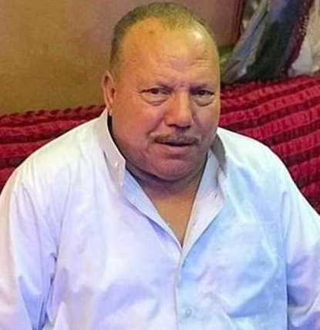
Buyer Persona B:
حاج نادى السباعي
Demographics:
Age: 45-65 years
Gender: Male
Location: Based in Cairo or another major Egyptian city
Role: Owner of medium-sized to Large Egyptian exporting company
Focus: Expand the company's global reach, increase market share, and secure long-term partnerships..
Challenges: Finding reliable buyers, language barriers, limited resources.
Needs: Trusted connections, affordable marketing, support from government agencies.
Lifestyle: Busy professional, often working long hours. driven by success. Enjoys traditional Egyptian culture and charity.
Interests: learning about new business trends.
Characteristics: Self-Made, Strong Trade Mindset, Risk-Taker

Slide 15

International Buyers
Buyer Persona: Mr. Jack
Demographics
Age: 25-50
Gender: Male
Location: Based in any country that has intentional trade agreements with Egypt
Role: Supply Chain specialist / Manager for a medium-sized to large international company
Focus: Finding high-quality, cost-effective Egyptian products. ensure product quality and compliance, and reduce supply chain risks.
Challenges: Finding reliable suppliers, ensuring quality, navigating the Egyptian market, and ensuring timely delivery.
Needs: Efficient sourcing platform, detailed product information, trust and transparency.
Lifestyle: Fast-paced professional, often traveling for work. Values work-life balance and enjoys spending time with family and friends.
Interests: Global culture, reading economical & political new trends, fitness, and staying updated on industry trends.

Slide 16
Targeting
Egyquette can address these needs by:
Connecting buyers and sellers directly.
Providing a trusted platform for verified suppliers.
Offering tools for marketing and promotion.
Ensuring product quality and compliance.
Simplifying the sourcing process.
Building trust and transparency.
02

Slide 17
Positioning
Proposition:
Egyquette website is Comprehensive, User-Friendly Navigation.
And Multilingual Support for both egyptian exporters and international buyers. Will show Detailed Company Profiles for verified businesses only.
Brand Differentiation:
Focus on Egyptian Businesses
Data Accuracy & Up-to-Date Information
03

Slide 18
Marketing Mix (4 Ps)
02
4 p’s
04
01
03

Slide 19
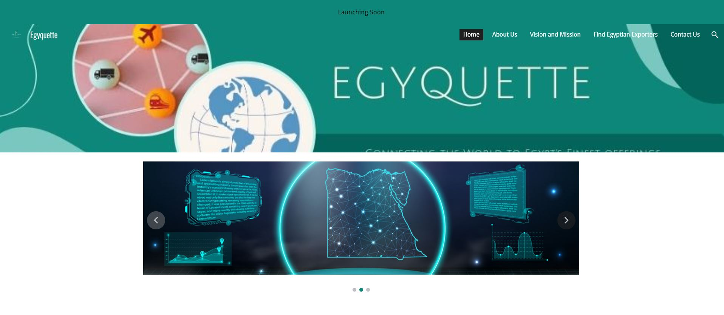
Product
Core: A comprehensive, user-friendly online directory listing Egyptian companies and their export offerings.
Features: Consider features like search filters by industry, product category, certifications, and minimum order quantity. Include detailed company profiles, contact information, product catalogs, and success stories.

Slide 20
Price
Free basic listings: Encourage company sign-ups with a free basic listing that includes essential contact and product details.
Premium listings: Offer premium listings and yearly Subscription “5000 EGP for Egyptian exporters & 100 USD for international buyers” with enhanced features like product image galleries, video showcases, and prominent placement in search results.

Slide 21
Place
Online platform: Develop a user-friendly website or mobile app accessible globally.
Offline place: our team will start from homes till we establish our headquarter in Cairo, Egypt
Search engine optimization (SEO): Optimize the platform for relevant keywords to ensure international buyers can easily find it through search engines.

Slide 22
Promotion
Digital marketing: Utilize targeted online advertising, social media marketing, and email campaigns to reach potential international buyers, Linkedin Advertising.
Partnerships: Collaborate with Egyptian government export promotion agencies, trade associations, and international chambers of commerce to promote the directory to their networks
Sales People: Leverage a dedicated sales team to build relationships with clients and promote the platform
Direct Marketing: Reach out to potential clients through Emails, SMS Marketing, & What's App Marketing.
Advertising: Utilize online and offline advertising channels to increase brand awareness.
CSR: Demonstrate corporate social responsibility through community engagement and philanthropy.
Subscription Offers: Attract new users and encourage existing users to upgrade with attractive subscription options, free month subscription, promo codes.. Etc.

Slide 23
Action Plan
Task | Assigned Person | Cost | Duration
Create a content calendar for social media posts | Mohamed Alaa | 200 USD | Monthly
Design and develop a user-friendly website and mobile app | Web Development Company | 2000 USD | yearly
Launch a targeted email marketing campaign to attract initial users | Shaimaa Magdy | 200 USD | Monthly
Partner with government agencies and industry associations | Marym Gamal | 1000 USD | Yearly
Create a social media marketing strategy and execute campaigns | Shaimaa Magdy & Mohamed Alaa | $200 | Monthly
Implement a customer relationship management (CRM) system to track leads and conversions | Marym Gamal | $100 | monthly
Conduct market research to identify key target markets and industries | Ebtsam Sabri | $200 | monthly
Track key performance indicators (KPIs) and analyze marketing effectiveness | Ebtsam Sabri | $200 | every 3 Months

Slide 25




Slide 26
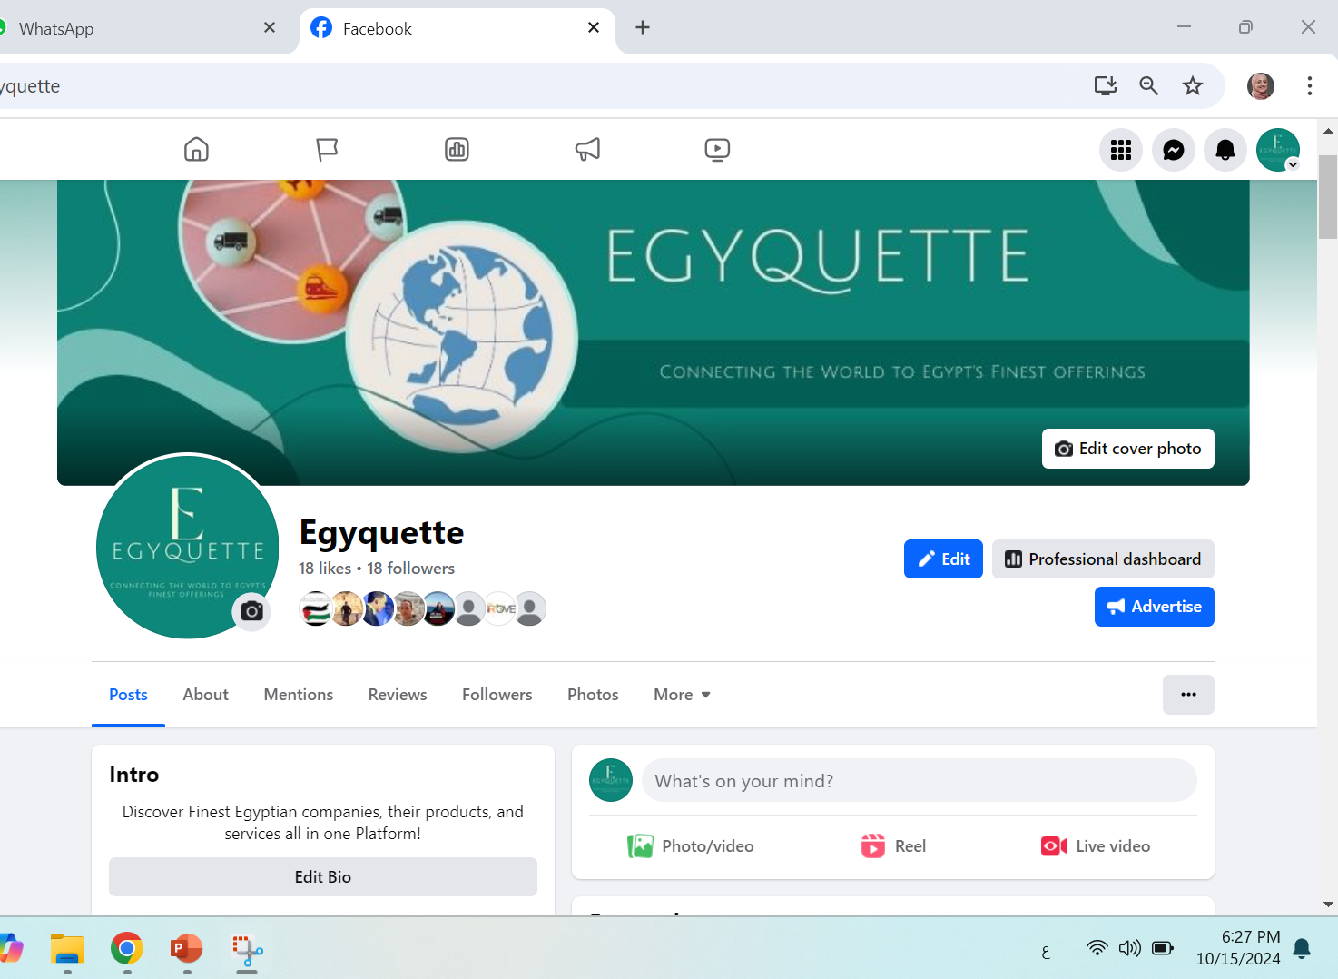

Slide 27
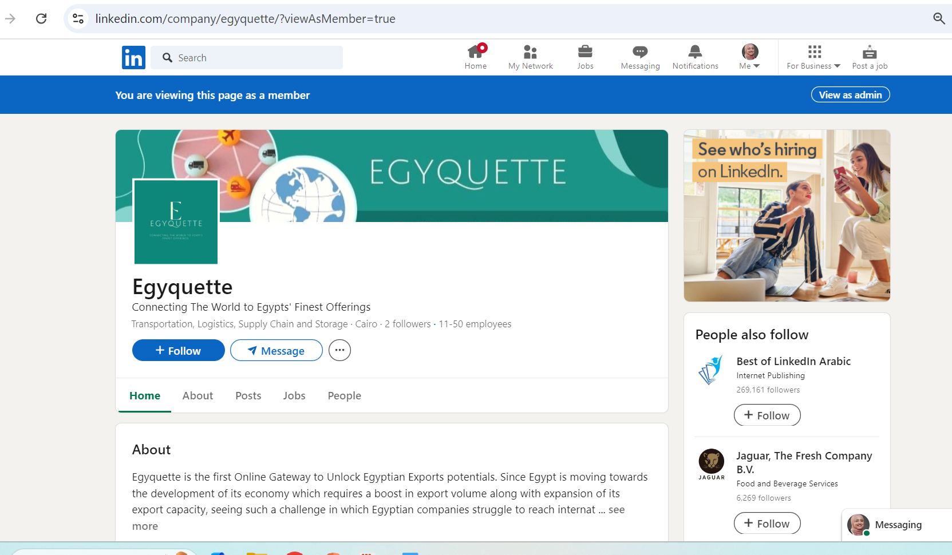

Slide 28
Date | Post idea | Content type | Post media | Target Audience | Assigned person
Sunday 06 Oct. | كيف بدأت فكرة إيجيكيت ؟ | Branding | Video | Egyptian Exporters | Marym
Wednesday 09 Oct. | هل تواجه صعوبة في بيع منتجاتك؟ إيجيكيت ستساعدك في العثور على العملاء المناسبين. | Educational | Image | Egyptian Exporters | Mohamed
Sunday 13 Oct. | عرض خاص للمستخدمين الجدد على إيجيكيت. لا تفوت الفرصة! | Selling | Image | Egyptian Exporters | Shimaa
Wednesday 16 Oct. | ماهى المشاكل التى تواجه المصدرين المصريين ؟ | Engaging | Poll | Egyptian Exporters | Ebtsam
Sunday 20 Oct. | Discover the world of Egyptian exports with Egyquette. Your gateway to quality products and reliable suppliers. | Branding | Video | International Buyers | Mohamed
Wednesday 23 Oct. | Did you know? Interesting Facts about Egyptian exports | Engaging | Image | International Buyers | Shaimaa
Sunday 27 Oct. | How Egyquette can make it easier to find the best Egyptian exporters | Educational | Image | International Buyers | Marym
Wednesday 30 Oct. | Promote a special offer or discount for new users. | Selling | Image | International Buyers | Ebtsam

Slide 29
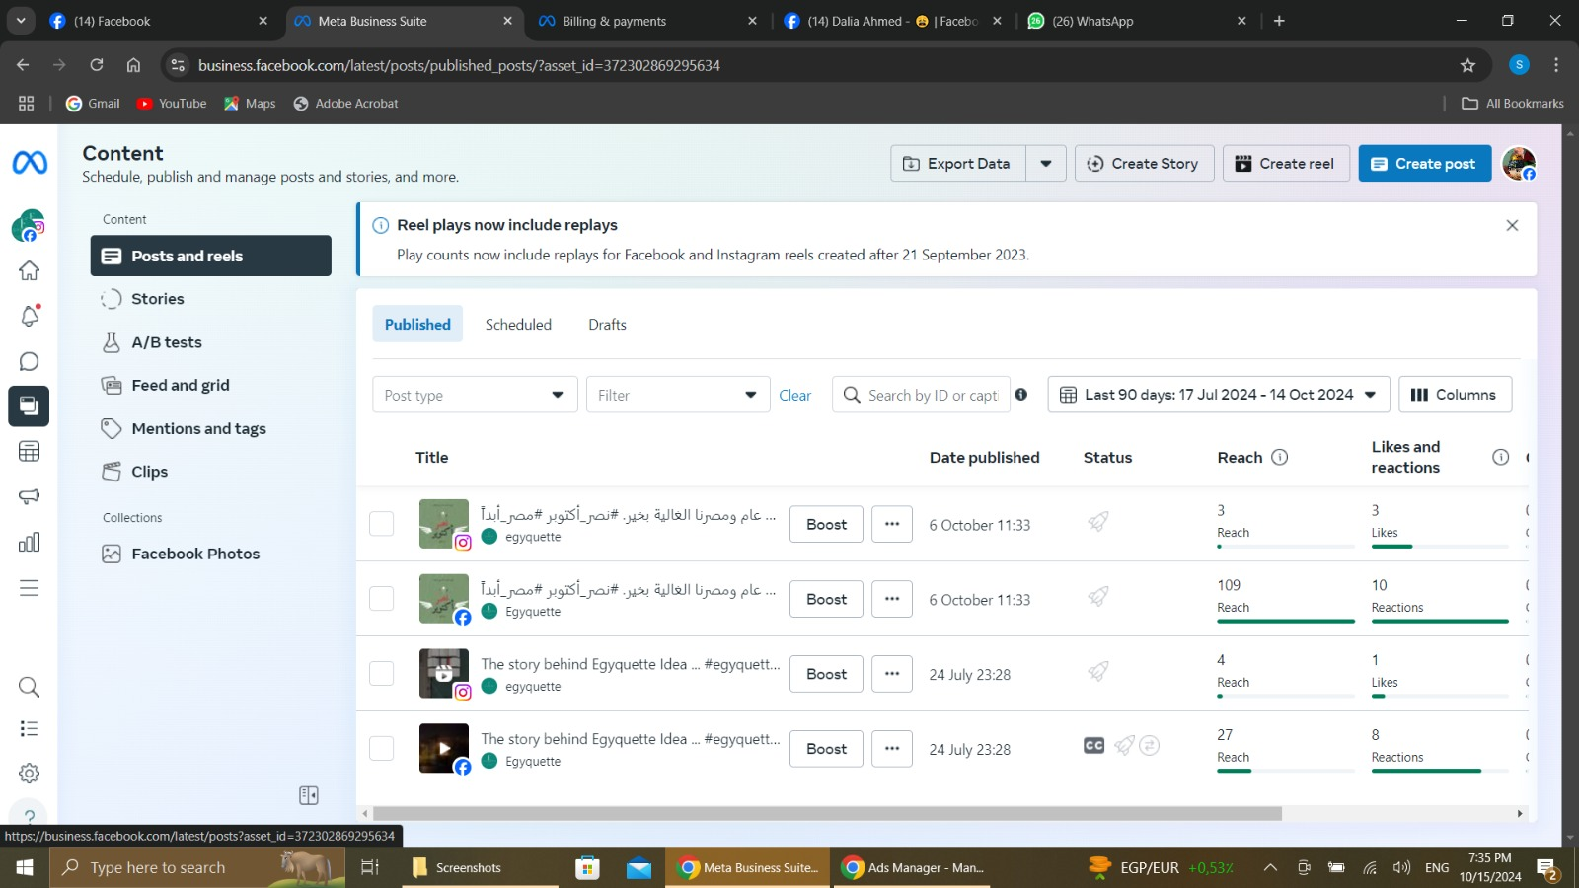

Slide 30
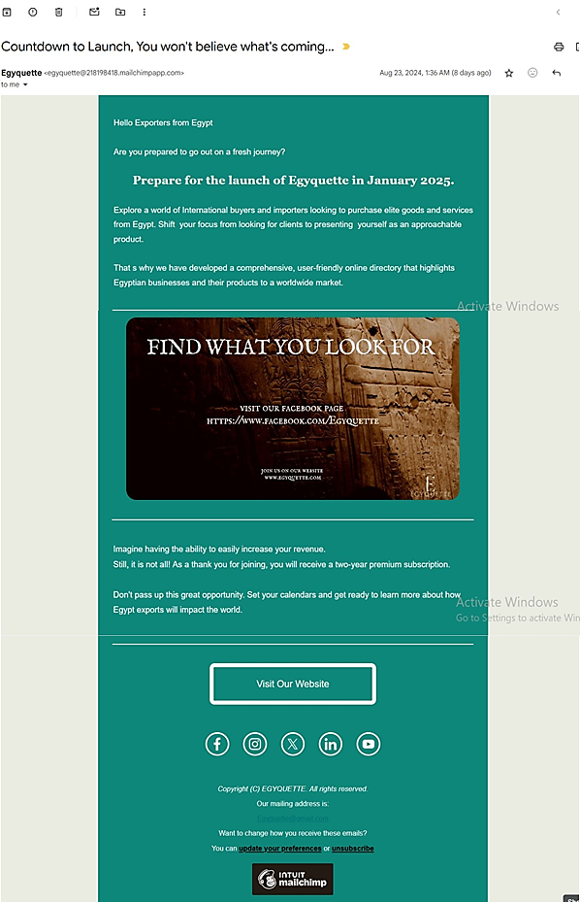

Slide 31
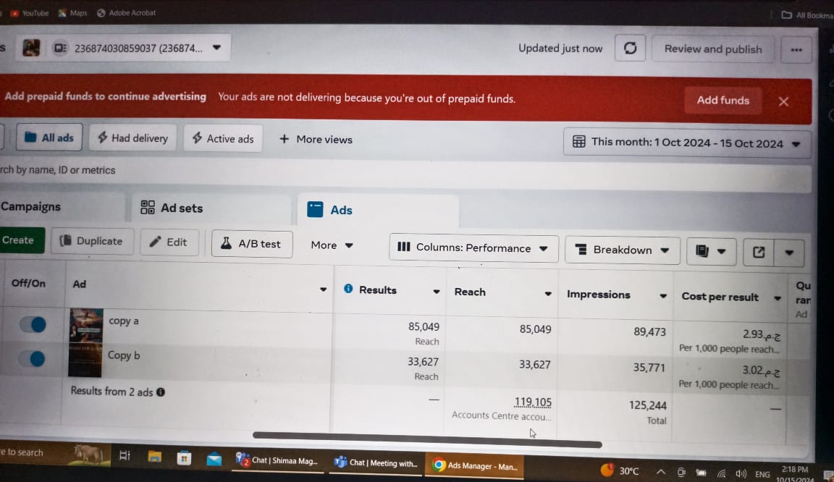

Slide 32
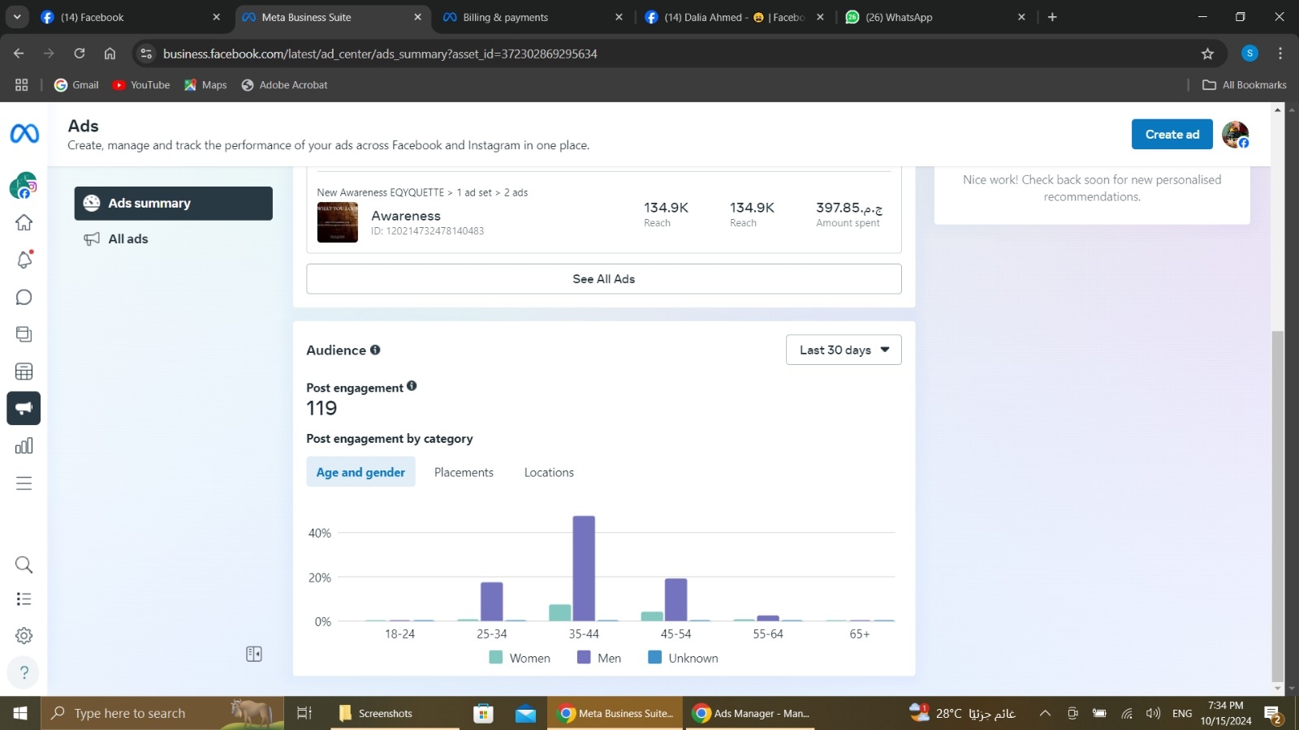

Slide 33
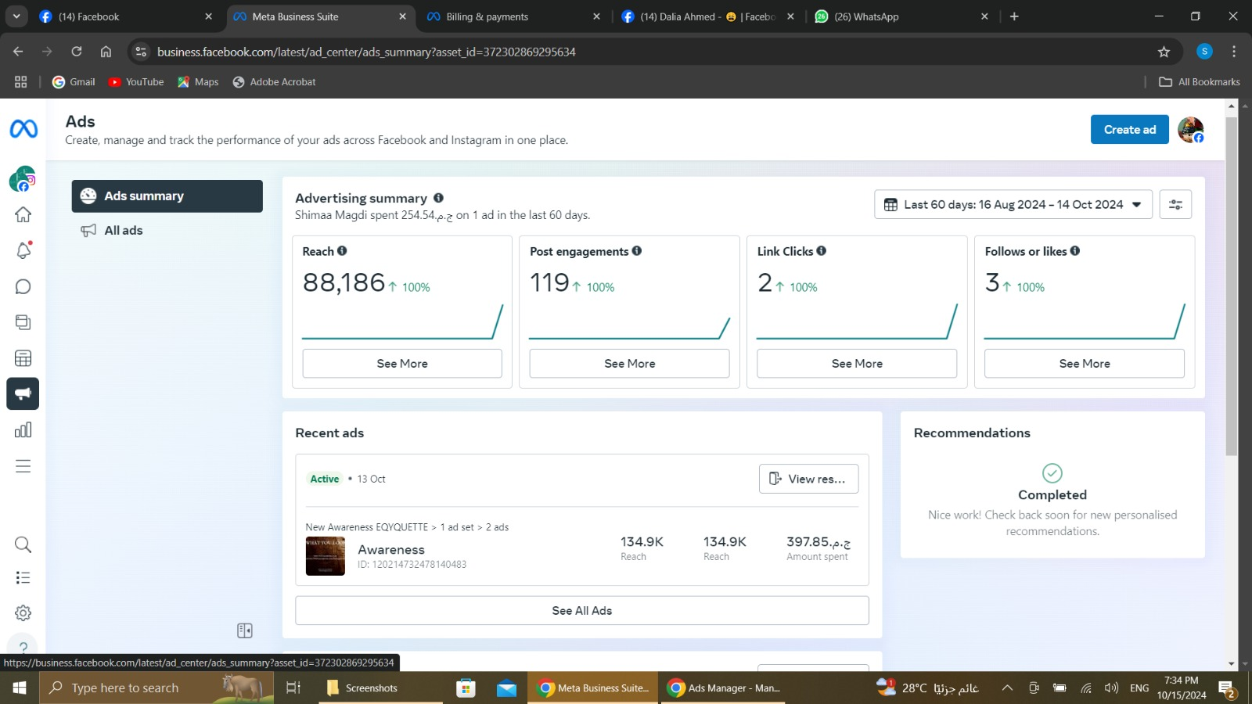

Slide 34
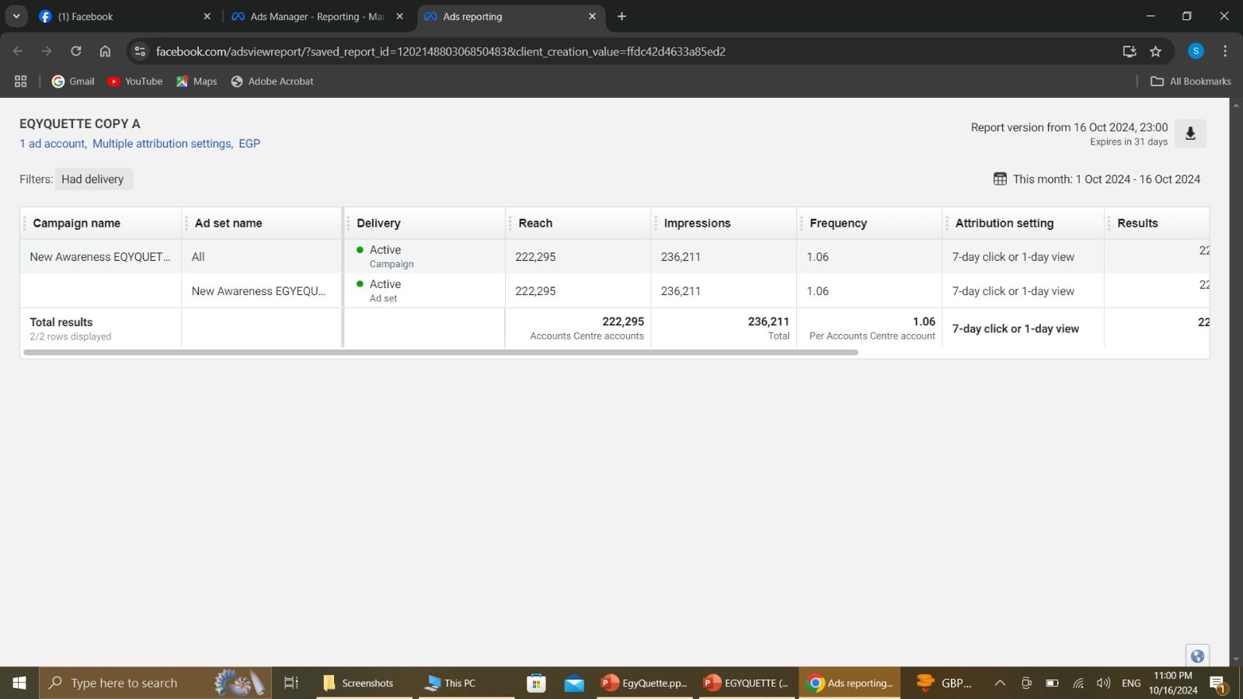

Slide 35
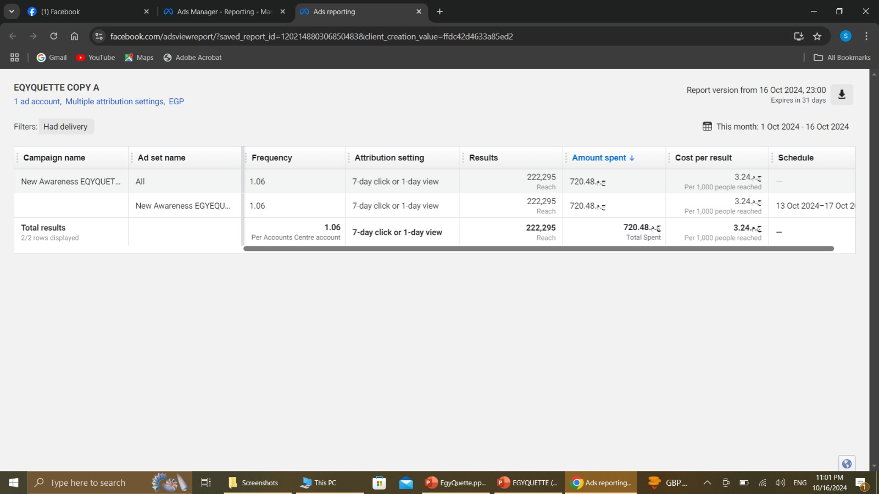

Slide 36
Controls
Track Key Performance Indicators (KPIs)
Website Traffic “our aim to reach 10,000 visits or minimum 8000 visits”.
Social Media Engagement “
Lead Generation “generate 100 leads or Min 70 per month”.
Sales “
Customer Satisfaction “ reach 80% customer satisfaction, measured through surveys”
2. Compare Performance to Objectives
Benchmarking
Goal Achievement.
Identify Gaps.
3. Analyze Data and Insights
Data Analysis.
Identify Trends.
Gain Insights.

Slide 37
Recommendations
Make Necessary Adjustments
Optimize Campaigns: Adjust marketing campaigns based on performance data.
Refine Targeting: Refine targeting criteria to reach the most relevant audience.
Improve Content: Create more engaging content like videos, polls & interviews with clients.
Allocate Resources: Reallocate resources to focus on LinkedIn paid ads & google ads and hold advertising on Facebook for the moment.
Continuous Improvement
Foster a Culture of Learning: Encourage a culture of continuous learning and experimentation.
Stay Updated on Trends and new regulations in logistics
Adapt to Changes: Be prepared to adapt marketing strategies as competition always evolving.

Slide 38


